Slide 1
Group 1 Project Members
Mr. Pramod S. Patil
Mr. Manish Tanwar
Mr. Sambasivarao Gadde
Mr. Omkar Ramdas Shivekar
Ms.Vaishnavi Rathore
Rajnandani Tanwar
Rahul Joyswal

Slide 2
Understanding the KPI’s
1. Year wise loan amount Stats
to understand how loan amounts have changed over the years.
2. Grade and sub grade wise revolving balance.
revolving balance for each grade and subgrade.
This can help identify if there's a correlation between a borrower's credit quality and their revolving balance.
3. Total Payment for Verified Status Vs Total Payment for Non Verified Status
We can compare the total payments made by borrowers with verified income/employment status versus those with non-verified status.
This can provide insights into the impact of income verification on repayment behavior.
4. State wise and last-credit-pull-d wise loan status
can reveal regional and temporal patterns in loan performance.
We can create a cross-tabulation or visualization to show the loan status distribution for each state and month/year of the last credit pull.
5. Home ownership Vs last payment date stats
number of days since the last payment for each category of home ownership (e.g. - own, rent, mortgage).

Slide 3
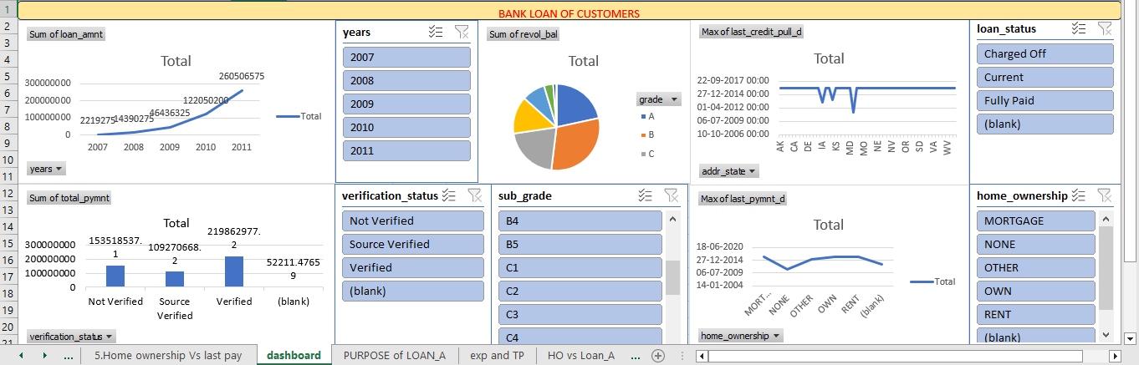
Excel Dashboard

Slide 4
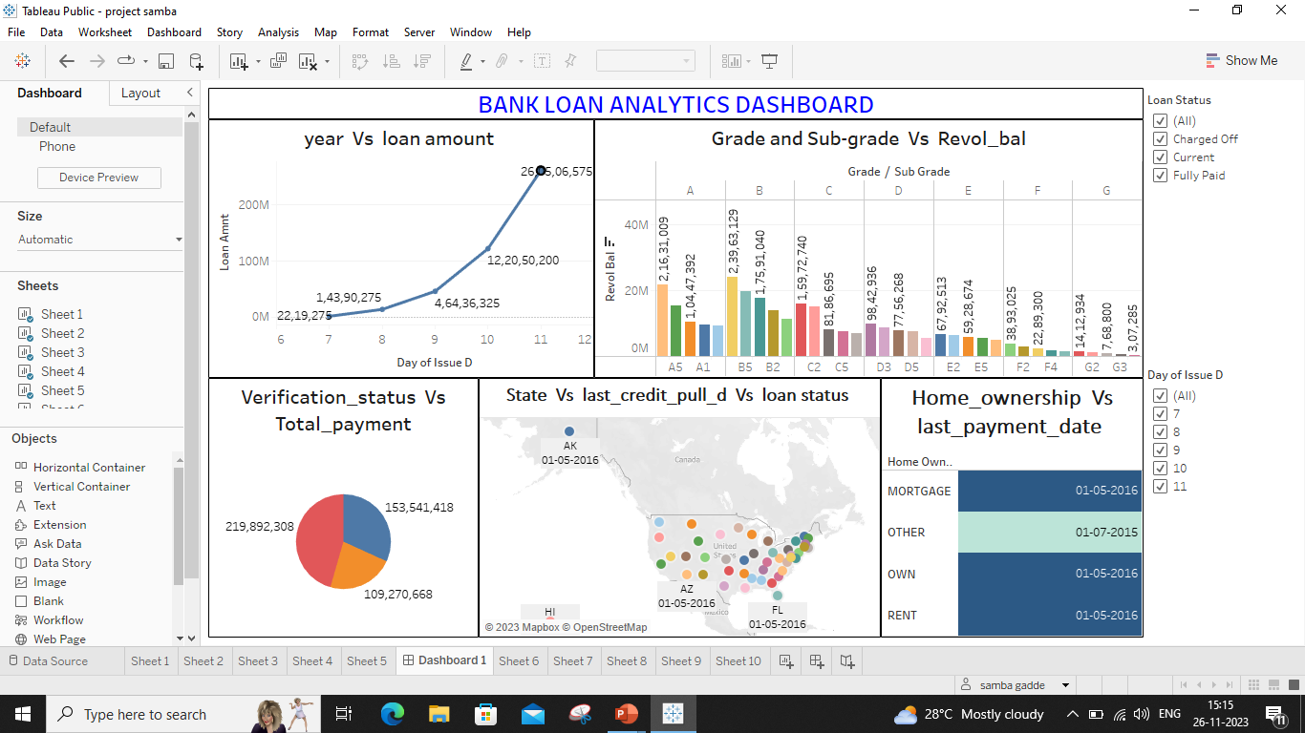
Tableau Dashboard

Slide 5
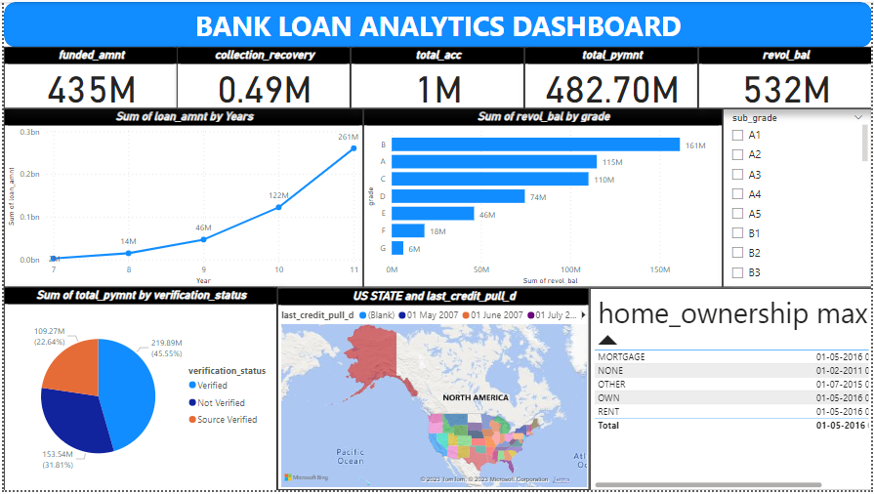
Power BI dashboard

Slide 6
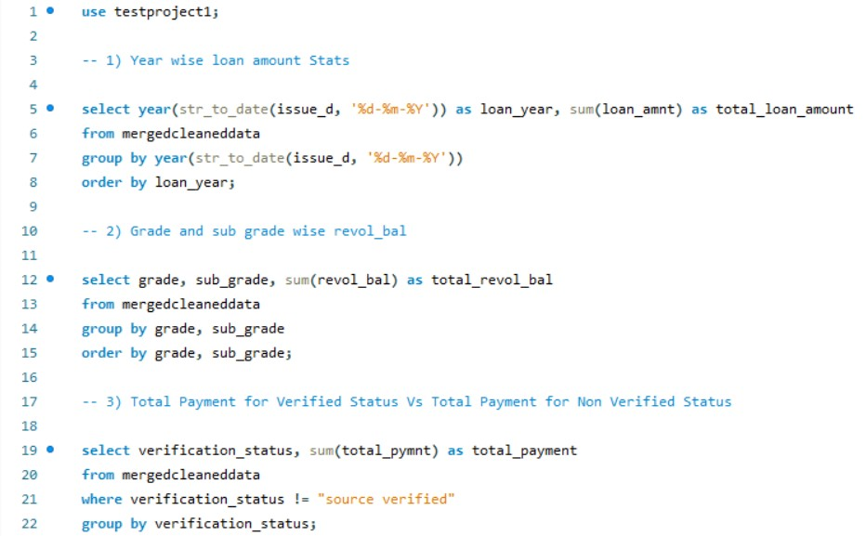
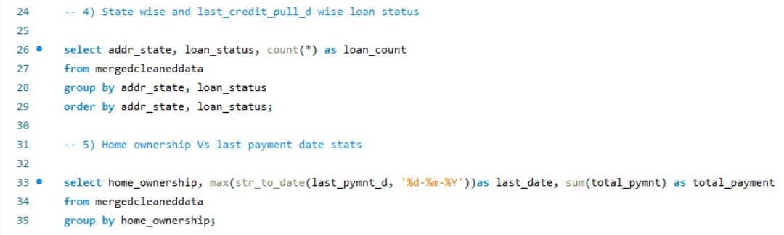
MySQL

Slide 7
Challenges
Unable to import the csv files into SQL.
excel – no issues
Tableau – no issues
Power Bi – no issues

Slide 8
Summary
Home Ownership(Mortgage) has received the largest payment of a total of $1,058,190 in March 2012.
As clearly shown 2011 has acquired a loan amount of 134 Millions.
As far as Grade and Sub-Grade- B3 stands the highest with 40M Revolving Balance.
Again California bags the highest in terms on loan amount and Washington has the highest average interest rate of 12.61%.

Slide 9
Thank You

